Slide 1
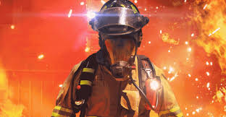
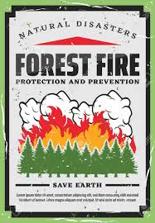

Wildfire Aid
Team 3:
Dominic Doringo , Joe Huang, Chad Keefer
Lilian Vu, Alfonso Monroy
https://github.com/lilianvu99/IEEE-Hackathon

Slide 2
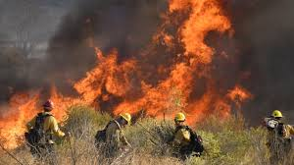
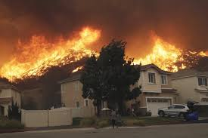
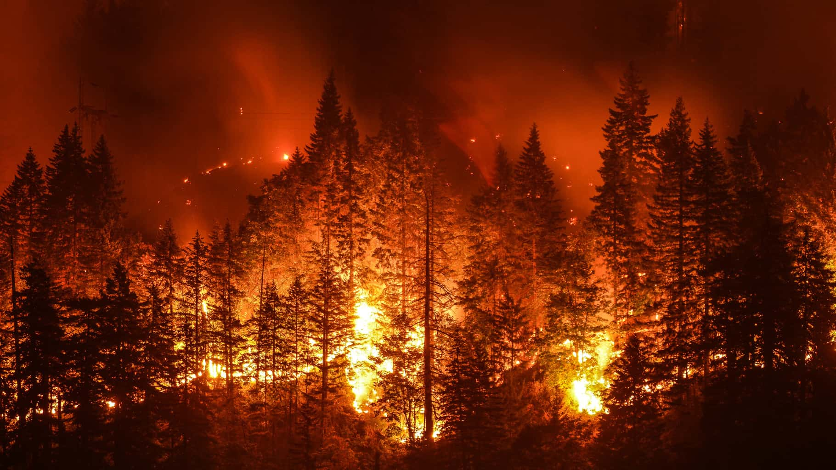
Environmental issue
One of the biggest environmental issue California faces is wildfires
Wildfire presents threats to our homes, depleting the earth's fragile ozone layer, and displaces the environment of species living in the area
In 2018 California suffered $400 billion dollars in damages regarding wildfires
This August a wildfire spread across the Amazon rainforest destroying over 2,240,000 acres of damage to an ecosystem of thousands of precious animal and plant species
With global warming changing our planet, wildfire becomes a bigger threat each and every day.

Slide 3
Key factors in cause of wildfires
Temperature
Temperature, is the single most important weather factor affecting fire behavior.
Air temperature has a direct influence on fire behavior because of the heat requirements for ignition and continuing the combustion process.
The higher the temperature the easier it is for combustion to happen
Fires burn more intensely in the afternoon. The temperature is the highest in the afternoon resulting in higher fuel temperatures for potential of combustion.
Humidity
→ humidity relates to the amount of moisture in the air, the lower humidity the dryer the environment will be.
→ dryer air due to the humidity levels makes the plants dryer themselves and make it easier to catch and spread fire

Slide 4
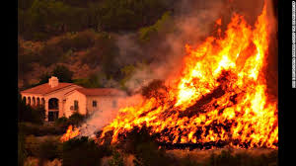
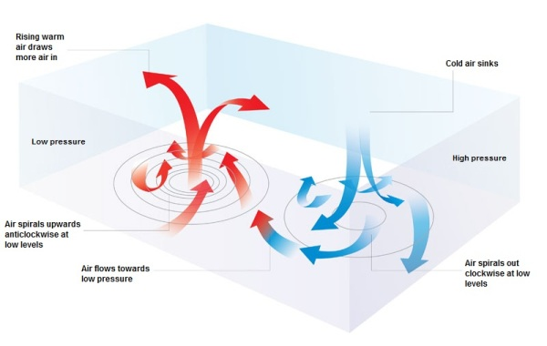
Key factors in spread of wildfire
Air pressure
→ Having one area with high air pressure and another area with low air pressure, the high pressure will move to the area with low air pressure to make equilibrium
In the case of wildfires if there is fire in a high pressure area there is a significant chance it will spread the fire to the area with a low air pressure system
Winds
→ The speed of the gust of wind will affect the speed and spread of a wildfire will
The direction of the wind also influences which direction the wildfire can spread

Slide 5

Proposed solution
Our solution in tackling the issue of wildfires is to implant a system consisting of
Temperature sensor
Humidity, sensor
Air Pressure sensor
Wind sensor
With these sensors it can detect if a specific area is
At risk of being affected by a wildfire or not

Slide 6
OUR SOLUTION to Wildfires
Our solution in tackling wildfire is implanting a microcontroller system in known areas of high wildfire risk
Our microcontroller will be connected to sensors that can measure the temperature, humidity, and air pressure of an environment. It will put these factors into numerical data that can be relayed/broadcasted to a homebase where someone can see if this area is a high risk
It will alert the user if this area is highly susceptible to a start of a wildfire
If an area is highlighted as high threat we also propose to have a drone system attached with a flame and smoke detector to survey the area

Slide 7
Proposed implementation
We can use the data from our proposed implant to help in prevention
Using the resources allocated to us we will use the DHT11 temperature/humidity and BMP180 pressure sensors to detect whether or not there are ideal conditions for a wildfire to start
If the conditions are ideal, the stationary sensors will send out GPS signals for warning. We will send out drones with an MQ-2 smoke sensor and a flame detection sensor to scan the area for wildfire prevention process
Ideally if the drones detect a fire they will send out a GPS signal to a local fire station to tell them that there is a wildfire

Slide 8
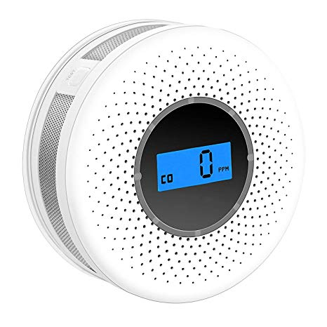
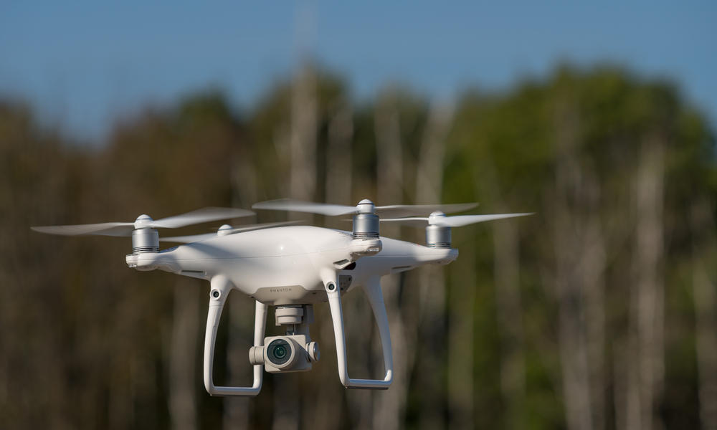
What our device will do
Implants
Prevention
Sends out early warnings/signals
BMP180 Air Pressure Sensor
Signal will be detected when air pressure is ideal for a potential wildfire
DHT11 Temperature / Humidity Sensor
Signal will be detected when temperature is ideal for a potential wildfire
Higher temperature + lower humidity = higher chances for wildfire
Drone aspect
Scouting and information
Smoke detectors and flame sensors will be working alongside to determine if a fire is present
MQ2 Smoke Sensor / Detector
Signals will be detected when drone suspects an area with smoke with fire
Flame Sensor / Detector
Signals will be detected when a fire is present
Data of how severe the fire is and the distance from the sensor will be sent via GPS

Slide 9
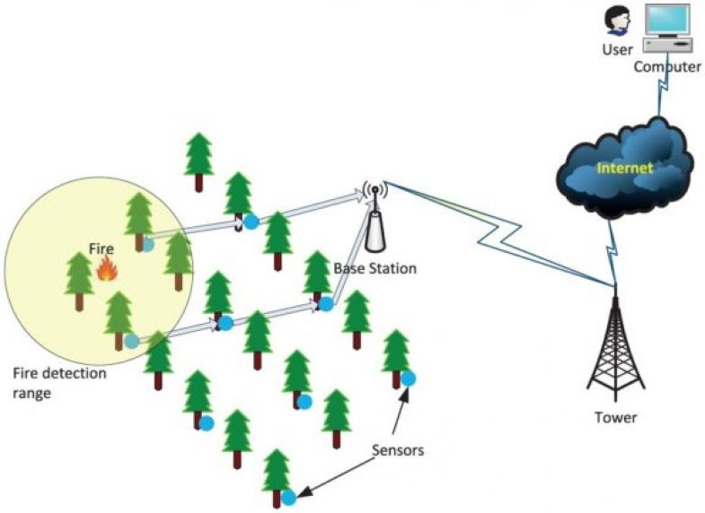
Implant
We propose to implant one of our system into well known wildfire location
We will use the Humidity/Temperature Sensor and Air Pressure Sensor to constantly feed data and information back to a user
If it goes over a certain threshold, alerts will be sent to database and flags the location to be kept an eye on
Preventions is a key aspect in this!!!
With our numerical data we can compare multiple different areas, it will feedback with data and tell us which areas are higher threats through our comparison of data

Slide 10
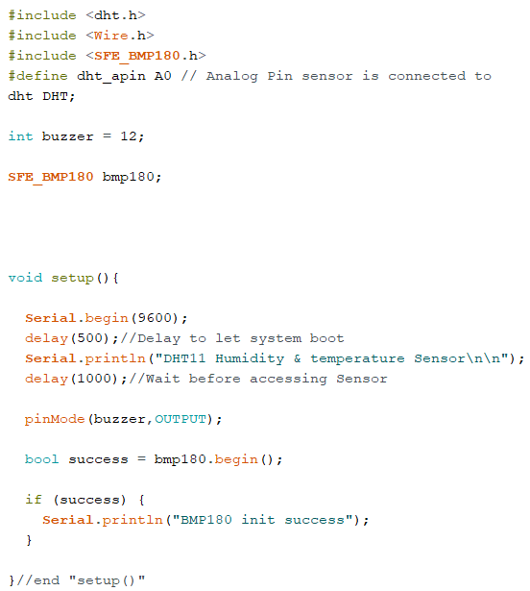
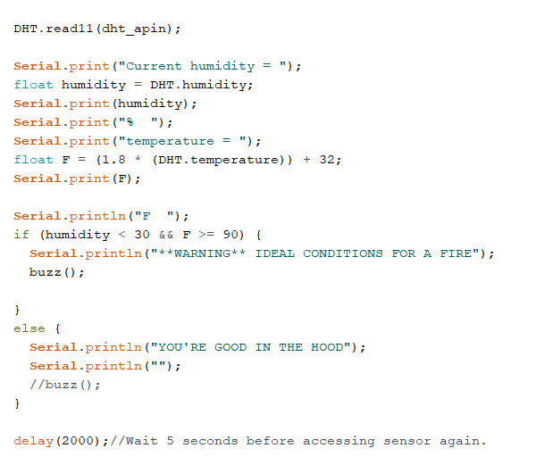
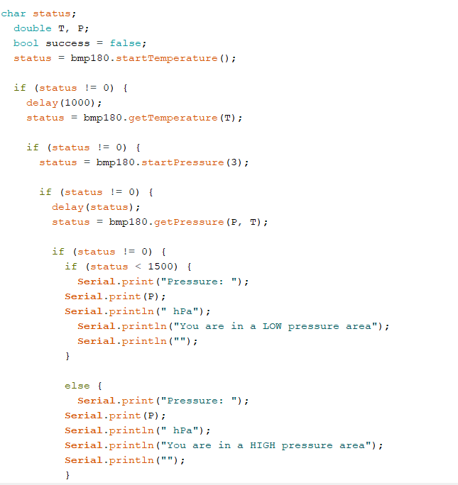
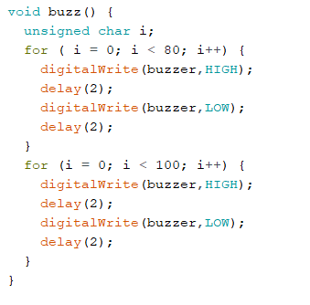
Terrain/Implant
Air Pressure Sensor
Temperature Humidity Sensor
Set Up
Buzzer Function

Slide 11
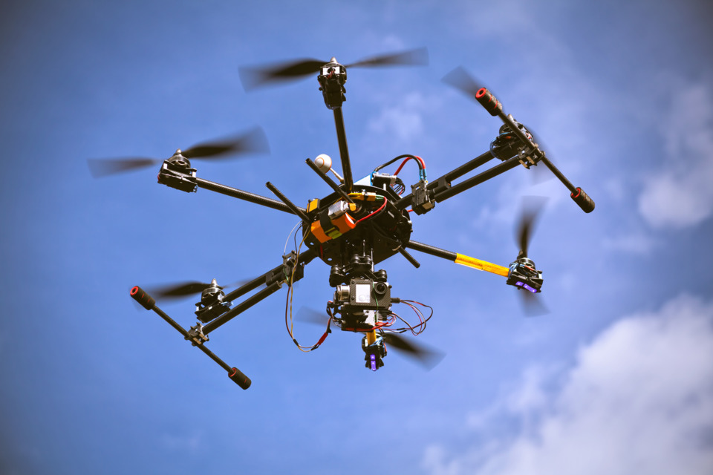
Drone
Drone will be attached with a MQ2 smoke sensor and a fire detector
Ability to put smoke and fire into numerical data that can be analyze and observed
What this will do is it will scan an area:
Flame sensor will be able to measure how severe the flame is
Ability to scout information without the risk of a helicopter / human pilot
Using the drone data we can scout for the core of the fire and through GPS it will relay information back to the firefighters
With that information the firefighter can have a better idea for their strategy of combating the fire where to plan their attack tackling the issue

Slide 12
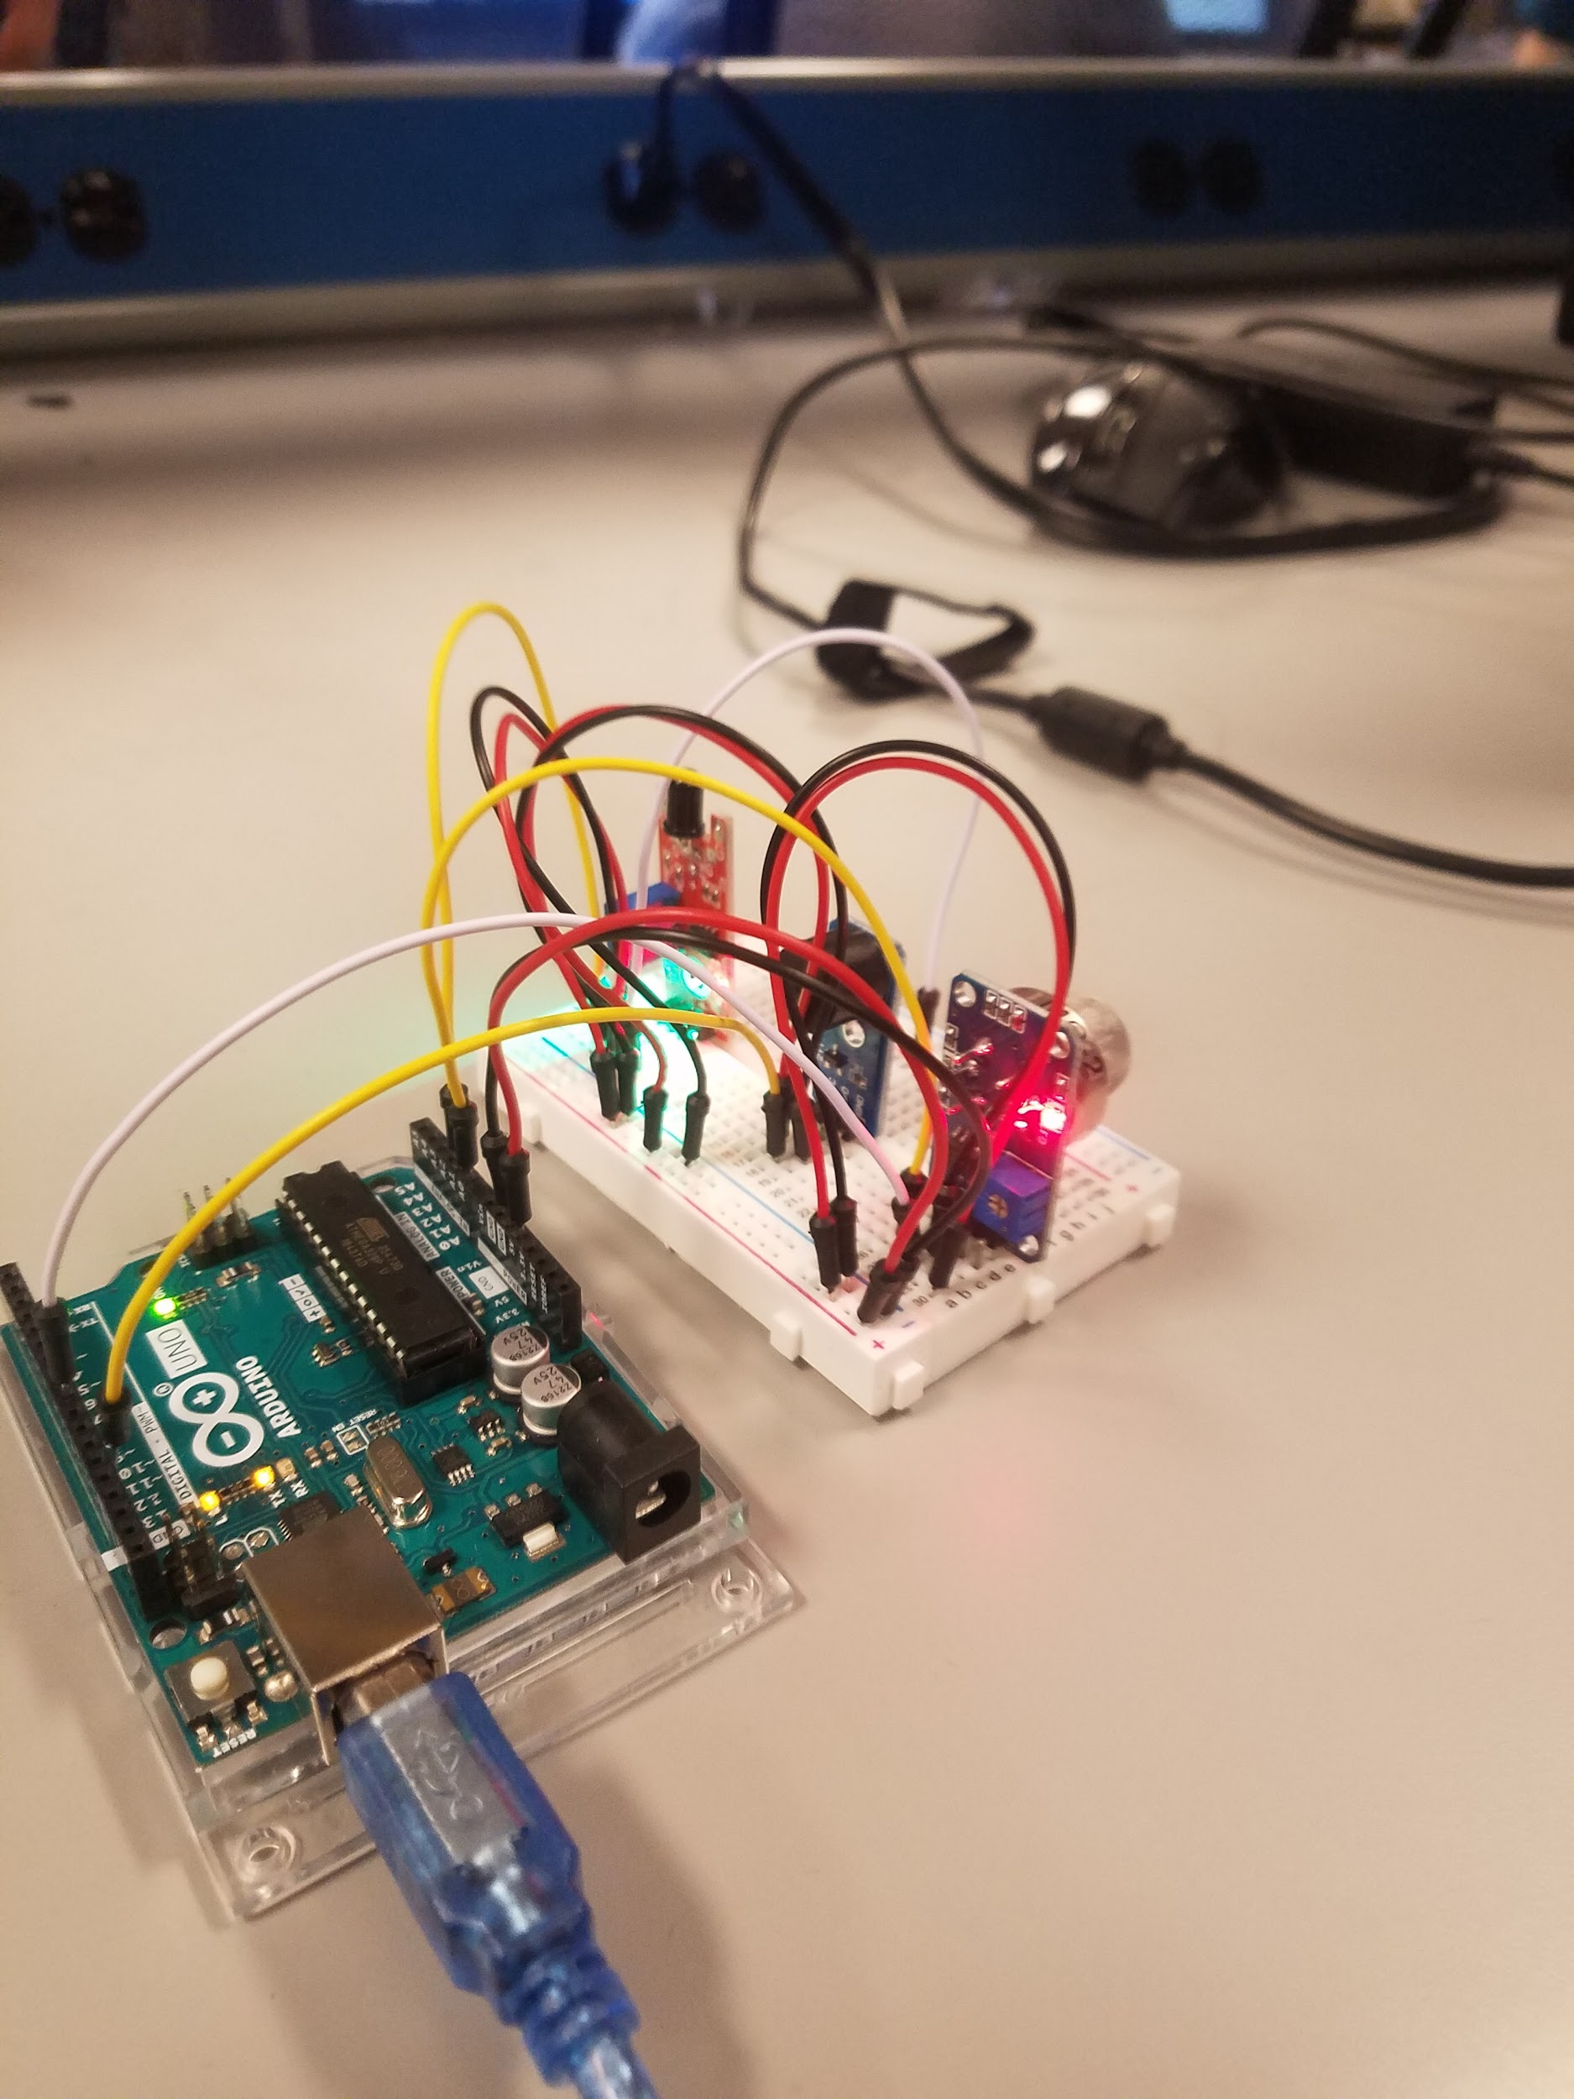
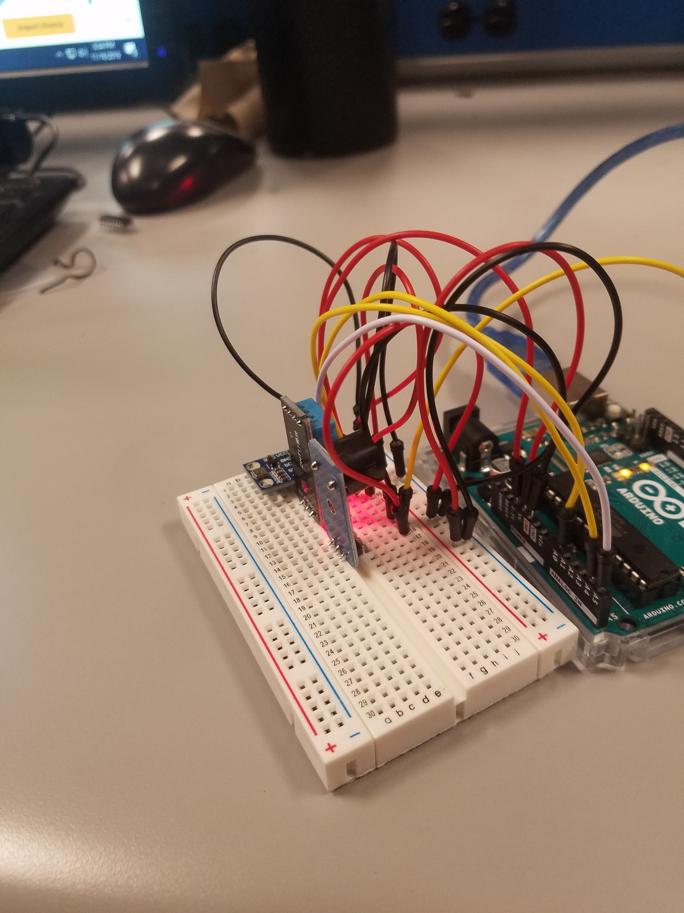
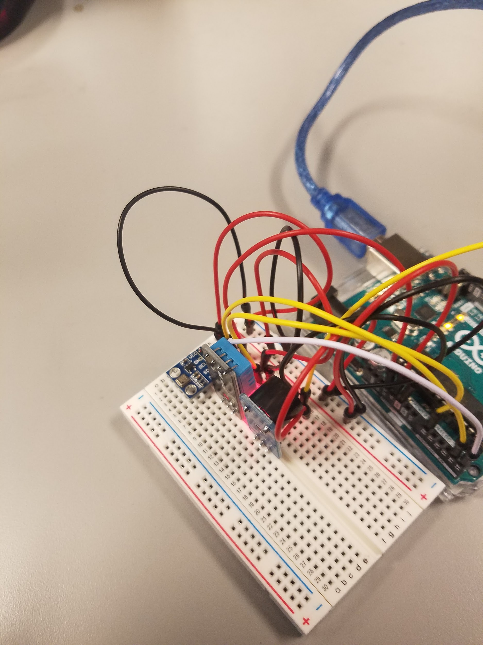

Slide 13
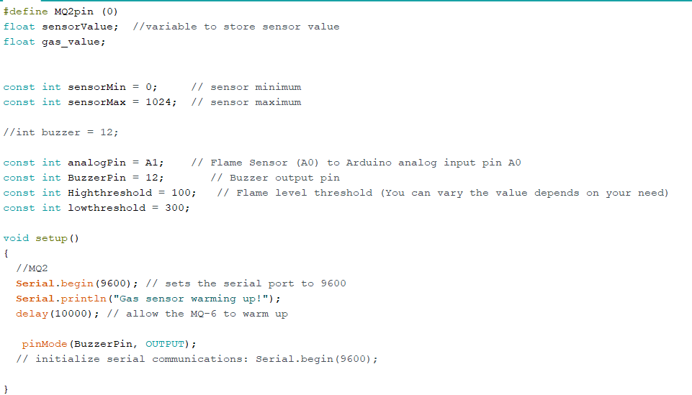
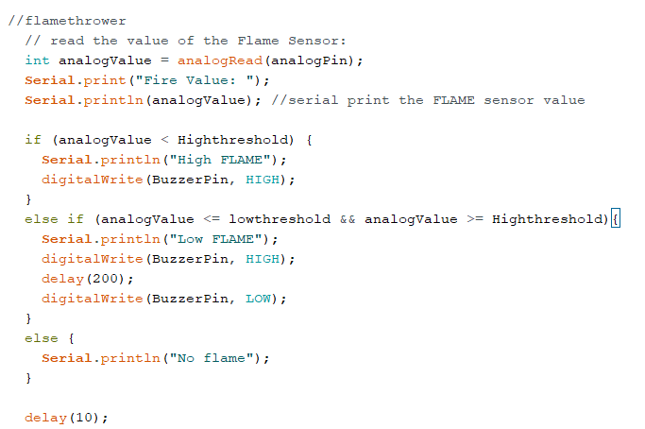
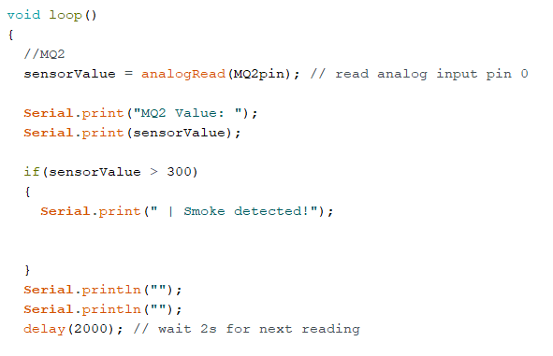
Drone
Set Up
Smoke Detector
Fire Detector Sensor

Slide 14
What needs to be added and implanted in our project
Wind sensors
Wind plays a major role in spreading and lighting up wildfires
Through the data we obtain from a wind sensor, we can more accurately prevent a wildfire
Data Transfer
Relay information to a database
Database can be read through serial transfer or bluetooth information
GPS Signaling and Camera
For when drones detect fires and send signals on location
Power Generators
Power up sites and drone

Slide 15
Potential issues with our project
False alarms can happen which can cause a needless call for fire fighters
Figuring out what the pressure levels we need to work with
Varies for different places where we place the implanted sensors
Drones can be caught in trees, collide with airborne objects, etc that will cause for either lost or nonfunctional drones
Might not be very cost efficient and requires high maintenance

Slide 16

Future endeavours
Using our data gathered from our implant and drone there is potential this data can be fed through advance artificial intelligence and or machine learning algorithms
With these advanced algorithms it can potentially predict potential wildfires in a fast and efficient manner, detect, and model risks
Advancement in Image processing can lead to the drone be able to scan an area and use image processing to gather and predict where the flame will go and give potential solution in where the fire can best be put out
Time is a very important factor when tackling wildfire
the longer you wait, the more fire spreads and damages occur
Having a basic proposed plan from image processing can give the the user
A faster response to deal with the fire

Slide 17
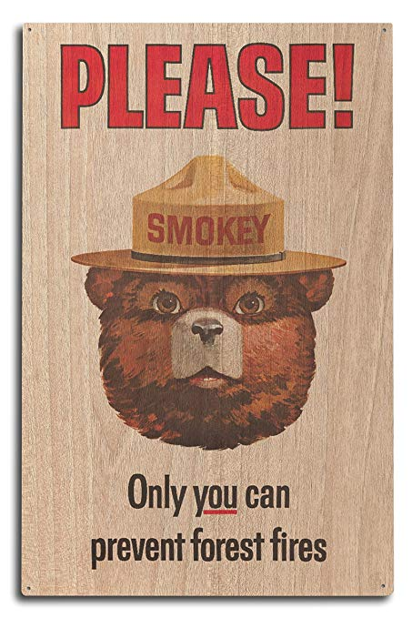
Thank You

